Slide 1
Advanced Debugging Tips and Tricks

Slide 2
Advanced Debugging Tips and Tricks
Configure behaviours to dedicate a tab for debugging
LLDB Expressions can modify program state
Use auto-continuing breakpoints with debugger commands to inject code live
Create dependent breakpoints using “breakpoint set —one-shot true”
“po $arg1” ($arg2,etc) in assembly frames to print function arguments
Skip lines of code by dragging Instruction Pointer or “thread jump —by 1”
Pause when variables are modified by using watchpoints

Slide 3
Advanced Debugging Tips and Tricks
Evaluate Obj-C code in Swift frames with “expression -l obj -0 — <expr>”
Flush view changes to the screen using “expression CATransaction.flush()”
Add custom LLDB commands using aliases and scripts.
Alias examples
command alias poc expression -l objc -0 —
command alias commodeFlush expression -l objc — (void)[CATransaction flush]
The nudge LLDB Script

Slide 4
LLDB: Beyond “po”
Use v, p, and po to print variables
Customize data formatters
filter,
summaries and
synthetic children
Use of Python3 for scripting

Slide 5
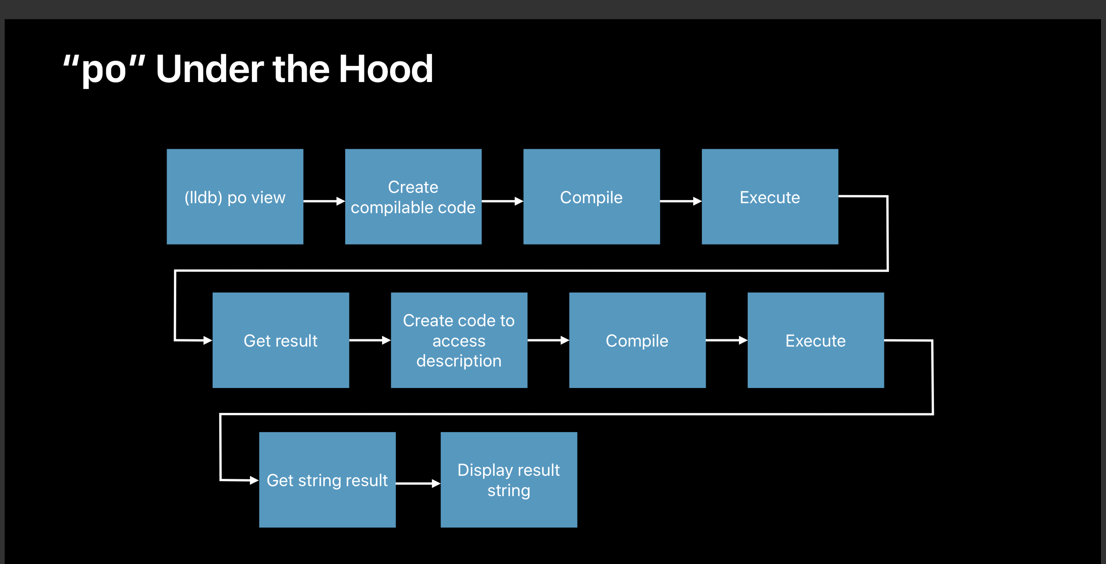

Slide 6
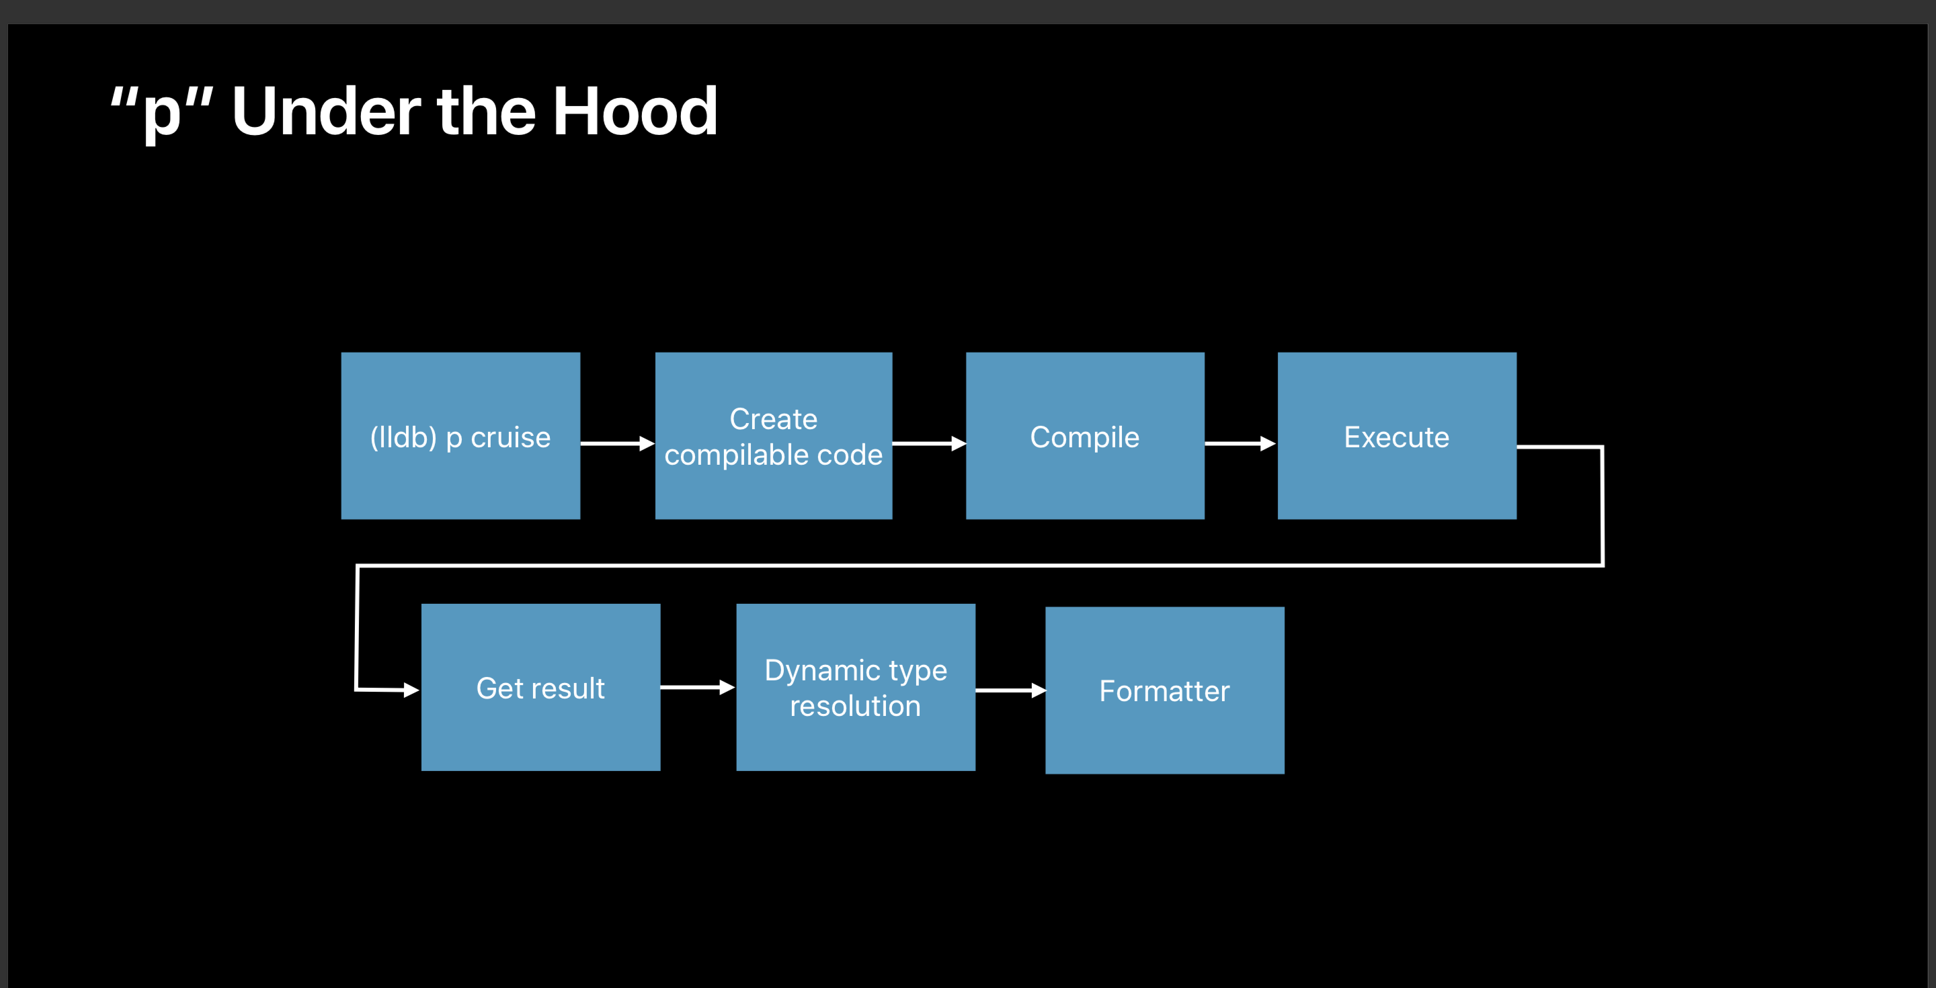

Slide 7
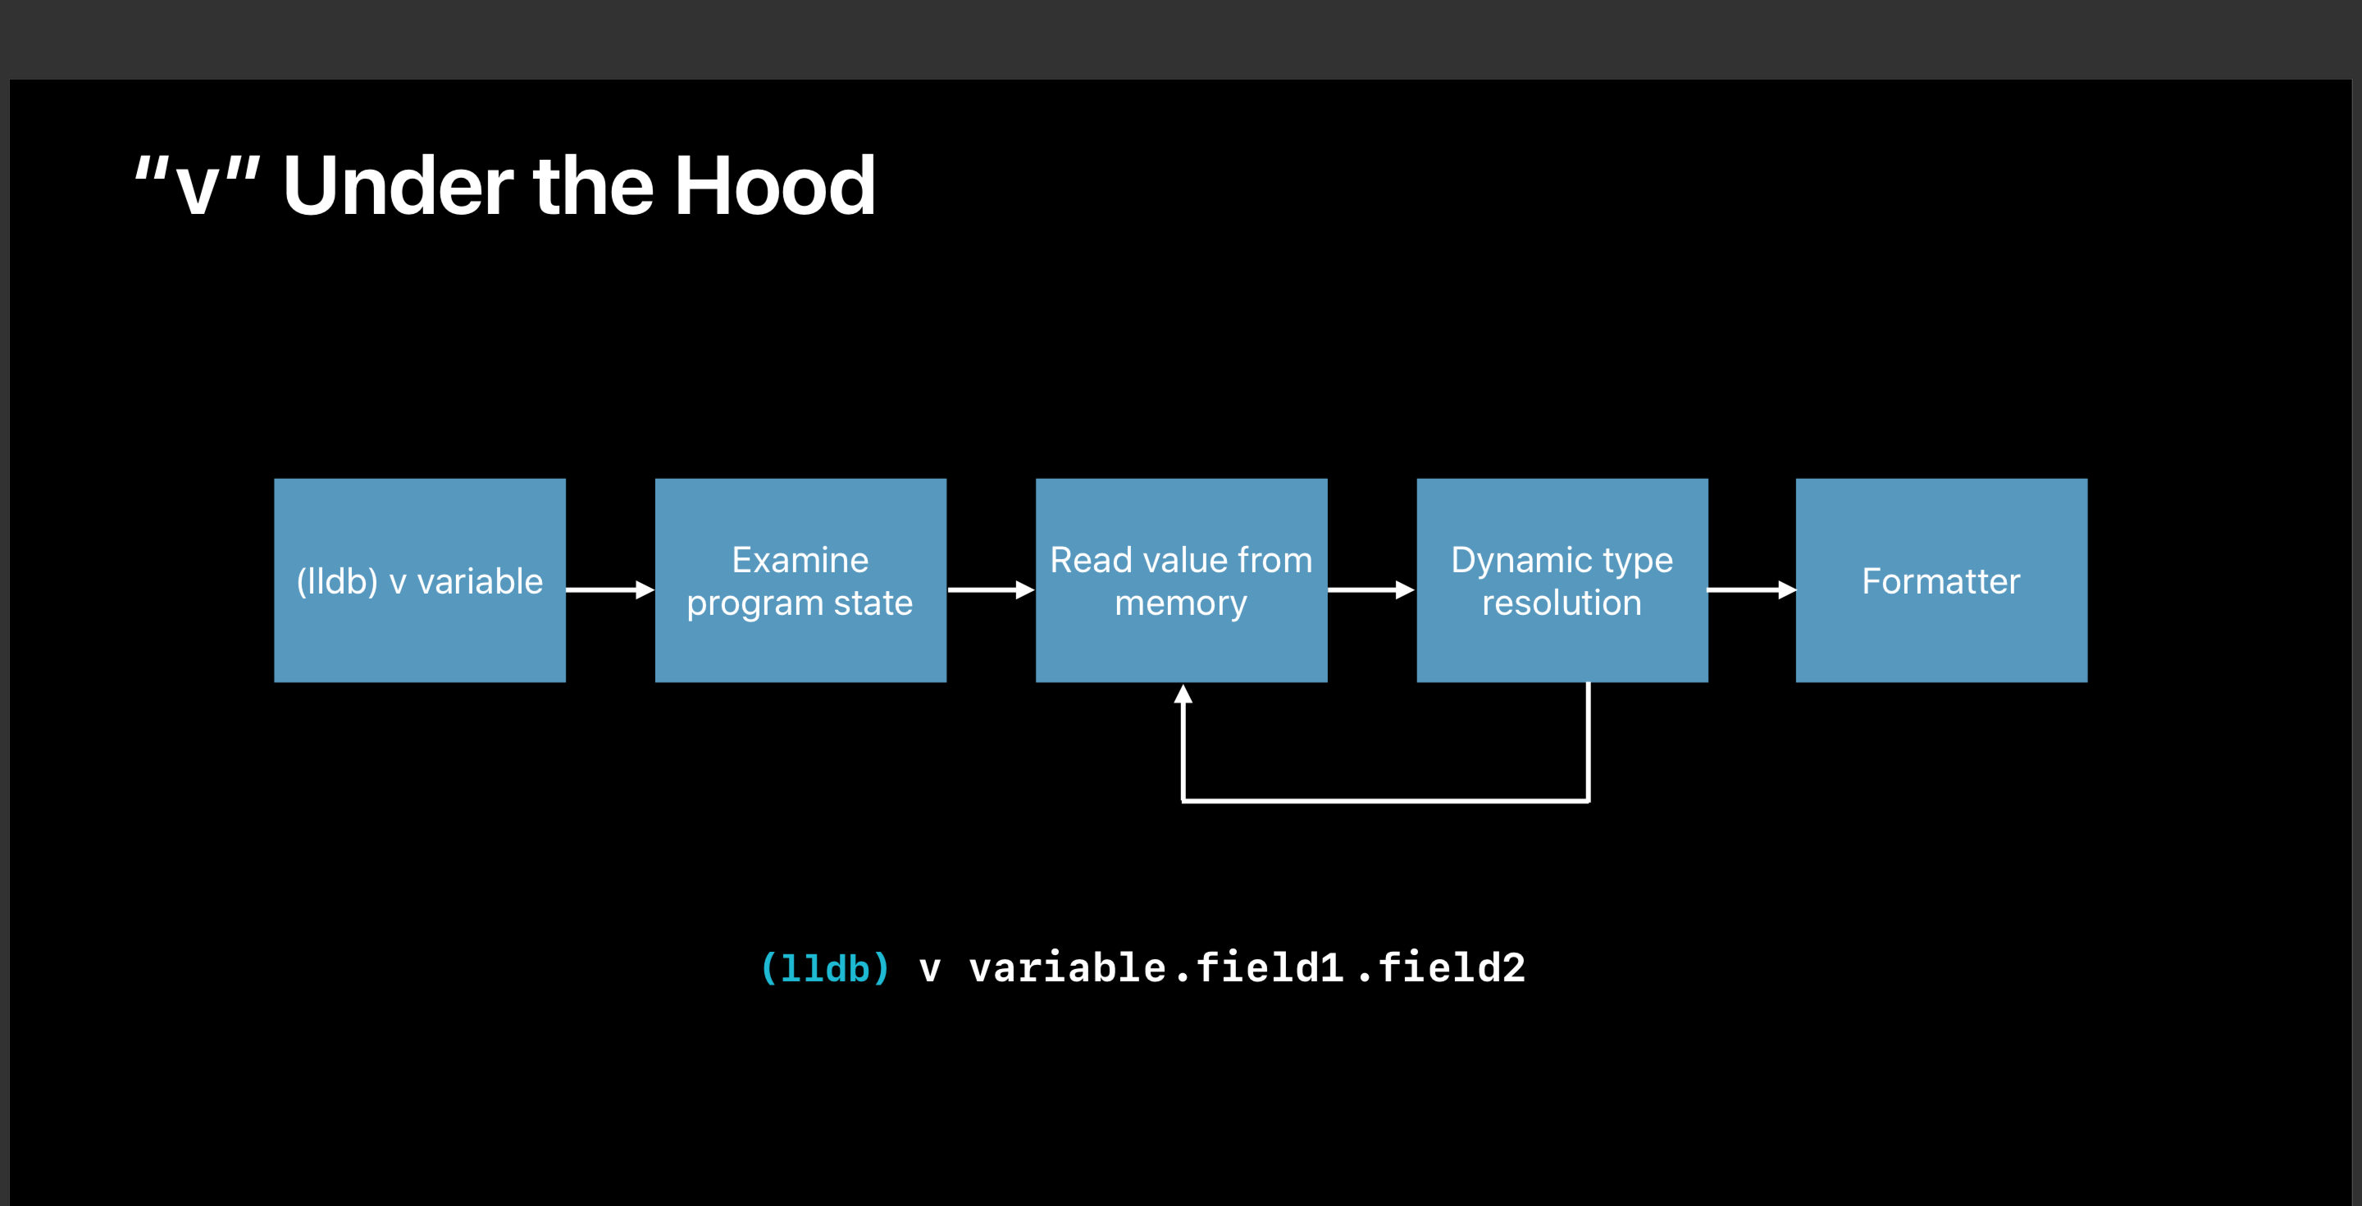

Slide 8
